Slide 1
Sensor Technology for Ice Hockey and Skating
[ Michael Hardegger, Benjamin Ledergerber, Severin Mutter, Christian Vogt, Julia Seiter, Alberto Calatroni, Gerhard Troster ]
Presented by:
Karan Shah
Aagam Shah
Pranav Shankar

Slide 2
Outline
Past Research
SkateTracker
Sensorized Hockey Stick
GameTracker
Conclusion & Thoughts

Slide 3
Past Research
Sensor-based analysis of power strokes and high impact injuries during hockey
FWD PowerShot1 device by Quattriuum
Instrumented mouth-guard
Wearable & Wireless sensor system for evaluating professional players in baseball
Notes:
Power shot1 : A system for measuring the timing of shooting motions in hockey is commercially available.
Instrumented mouthguard for measuring linear and angular head impact kinematics in american football

Slide 4
Aspects Focused
Skating – SkateTracker
System for monitoring skating & recognizing relevant events such as power strokes, turns, curves etc.
Shooting – Sensorized Hockey Stick
Measuring stick’s motion in space, it’s flexion, and the hand positions while playing.
Gameplay – GameTracker
Identification of relevant hockey game events along with game statistics without external surveillance.

Slide 5
SkateTracker

Slide 6
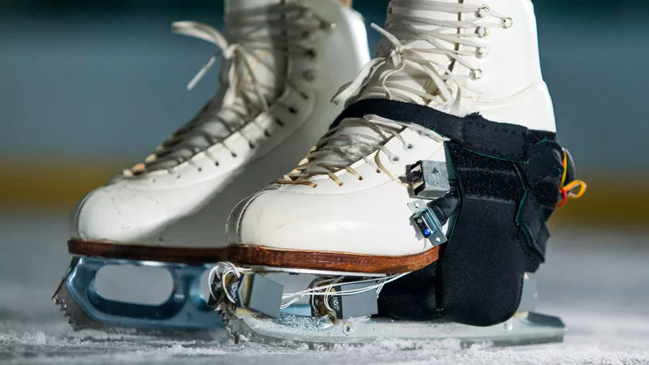
Introduction
Ice and Inline Skaters use almost similar accelerating and braking techniques.
Inertial Measurement Units (IMUs) clipped to the shoelaces of the skate.
SkateTracker performs:
Detection of Skating monitors in IMU acceleration and rotations
Derivation of features for each recognized skating action
Offline in Matlab
Propose a mobile app for assistance
Immediate feedback absent
Notes:
SkateTracker derives features for each recognized skating action, such as timing characteristics and maximal accelerations for power strokes, and the foot’s orientation at a specific point in time.

Slide 7
Method
Machine Learning approaches used:
Feature-based classification
Template Matching
Feature-based classification:
80 statistical and frequency features and reduce using mutual information
Template matching:
k-means clustering to fuse input into one-dimensional sequence.
LCSS algorithm:
Similarity (training, test) > threshold_{LCSS} , corresponding action recognized
Motion detection catergories
Short activity (jump, turns, breaking)
Longer activity (narrow and steep curves, backward skating)
Power Strokes
Notes:
SkateTracker derives features for each recognized skating action, such as timing characteristics and maximal accelerations for power strokes, and the foot’s orientation at a specific point in time.

Slide 8
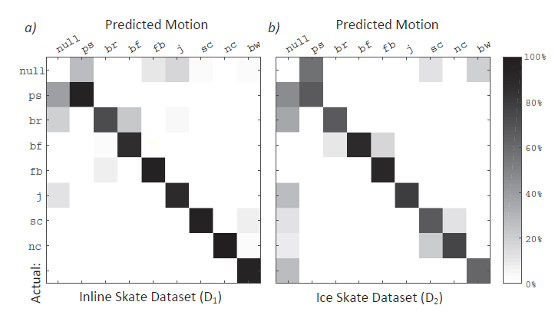
Evaluation
Action Detection
EXLs3 IMUs on right skate
GoPro HD2 with ANVIL
Random Forest with 20 subtrees performs best
Power Stroke:
Template matching best with F1 score = 0.94
Detection issues came for clockwise and anti-clockwise turns by different players.
Confusion Matrix
Notes:
Power strokes (ps), breaking (br), backward-forward turns (bf), forward-backward turns (fb),
jumps (j), step curves (sc), narrow curves (nc) and backward skating (bw).

Slide 9
Sensorized Hockey Stick

Slide 10
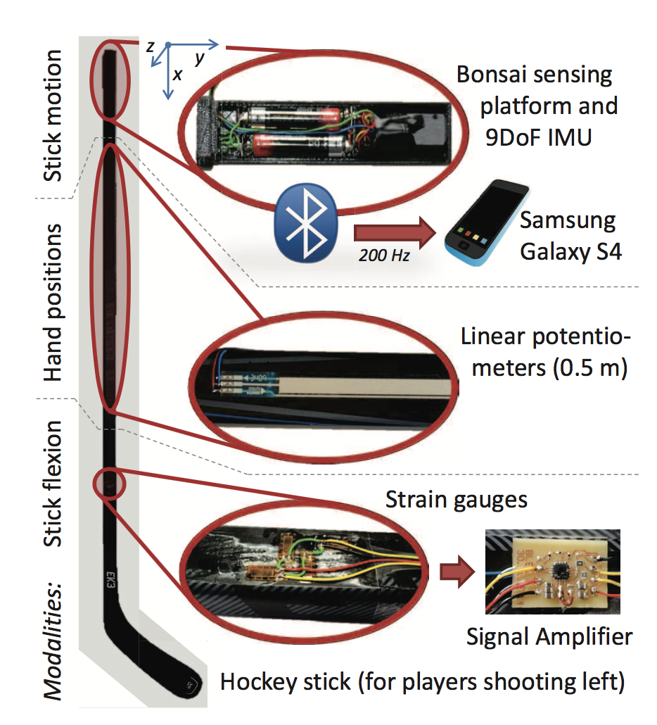
Method
Custom handle:
Bonsai Sensing Platform
Bluetooth
Bosch IMU
Pressure Sensitive Pots
4 strain Gauges (PDMS)
Amplifier

Slide 11
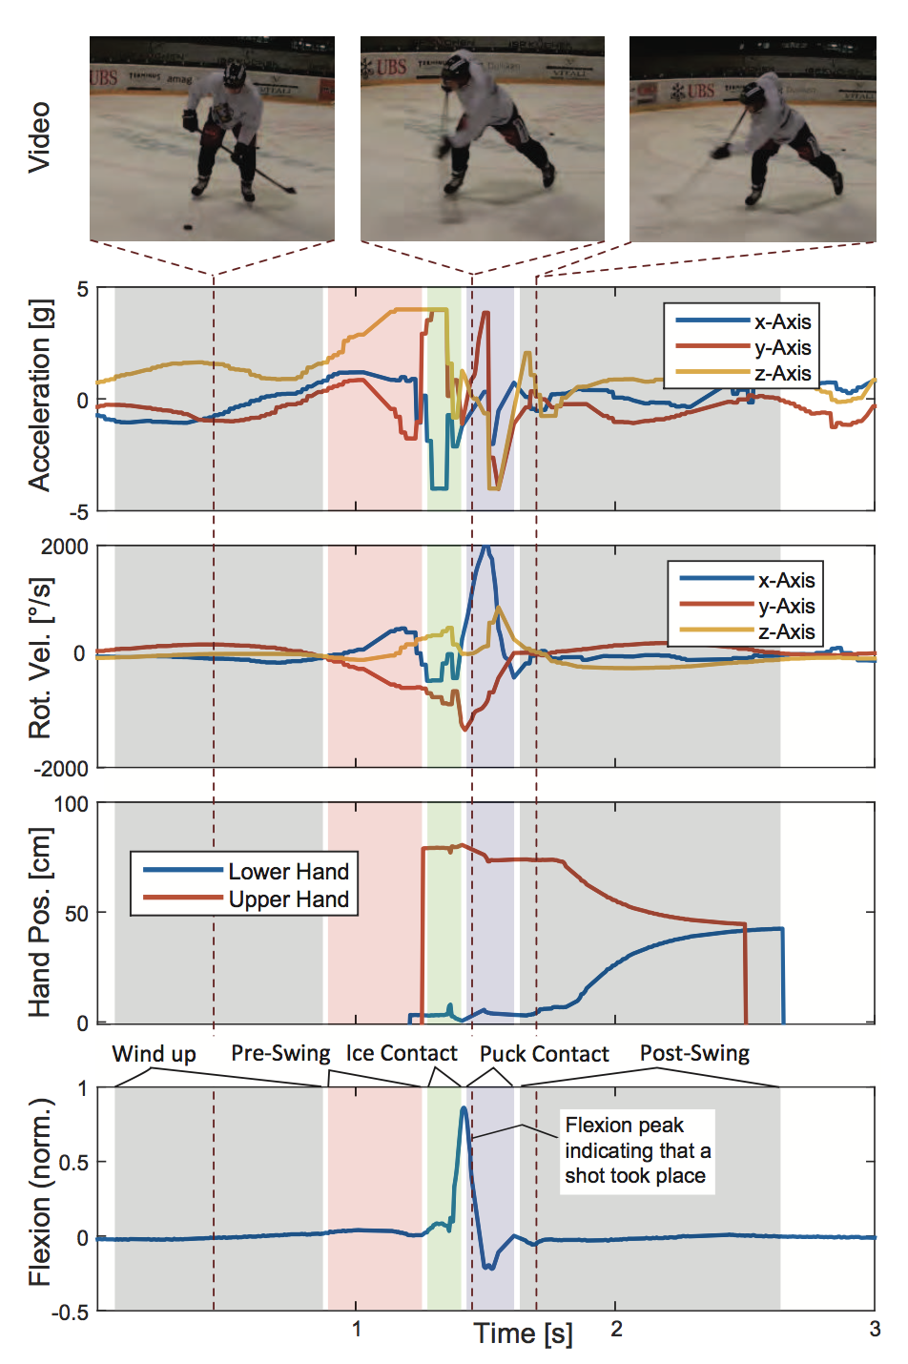
Raw Data
Analysis
Classification (rule based)
Wrist or Slap shot
Characteristic Features of each shot
Max, Min, Mean Rotational Velocities
Hand Positions
Max Flex
Date into a SVM

Slide 12
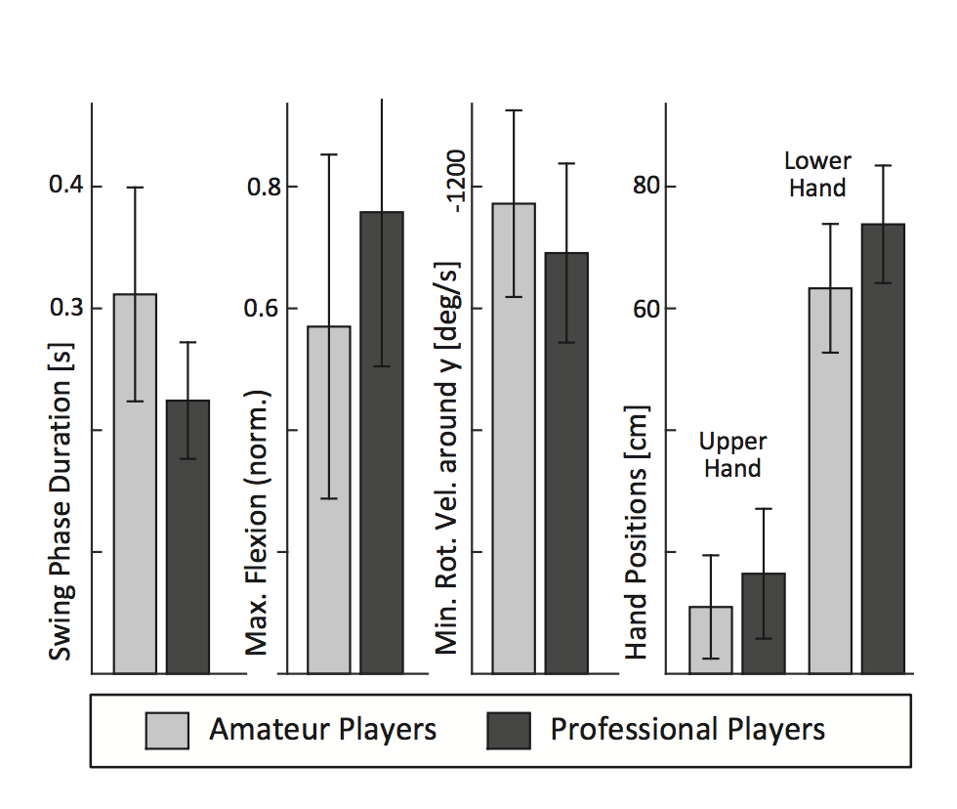
Evaluation
 | Amatuer (11) | Professional (8)
Wrist () | 43 | 26
Slap () | 21 | 10
11 Amateur and 8 Professional players
Data loss during High Impact Slap Shots
Slap Shots
Rotational Velocity
Flex
Swing Phase
Wrist Shots
Hand Positions + Above
Notes:
Power strokes (ps), breaking (br), backward-forward turns (bf), forward-backward turns (fb),
jumps (j), step curves (sc), narrow curves (nc) and backward skating (bw).

Slide 13
GameTracker
Notes:
Intro: assistants track the event of players such as count shots, goals, hits, time on ice etc. GameTracker with the help on wearable sensors, game events such as wrist shots, slap shots, hits, time in motion and breaks can be measured and calculated
Along with this, if the data is synchronized with regular game statistics, more events can be measured.for eg, if shot resulted in goal or not.
It can also identify different turns and backward skating which helps in determining if the palyer is playing offense or defence .

Slide 14
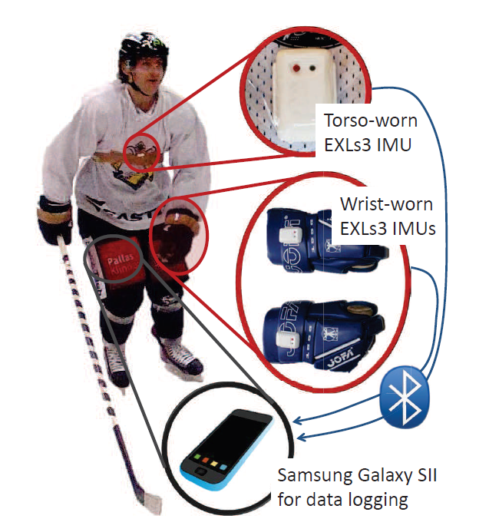
Method
Feature based classification
Spotting Gameplay events
Extracting Features
Training
Random Forest Classifiers
Recognition of period of times
Detection of period of times
Data collection by Samsung Galaxy SII via bluetooth
Notes:
Sensors to upper body and gloves to prevent getting damaged
Features are statistical and frequency with a window size WS and overlap SS = WS/8
Training of individual random forest classifiers (RFC algorithm for decision tree to model a system - Random forests or random decision forests are an ensemble learning method for classification, regression and other tasks, that operate by constructing a multitude of decision trees at training time and outputting the class that is the mode of the classes (classification) or mean prediction (regression) of the individual trees. Random decision forests correct for decision trees' habit of overfitting to their training set.
Short motion such as slap and wrist shots, hits turn; time periods of ice vs break
EXLs sample acceleration and velocity at 100hx

Slide 15
Evaluation
Motions of 4 professional players
Motions recorded
Slap shots (ssh), Wrist shots (wsh)
Hits, braking (br)
Backward – forward turns (bf), Forward – backward turns (fb)
10 rounds of circuit along with video recording
Initial performance optimization
Notes:
Most of shooters were right shooters, mirror of motion sensor data before feature extraction and aligned it with motion data of players shooting left
Leave one round out cross validation for initial performance optimization

Slide 16
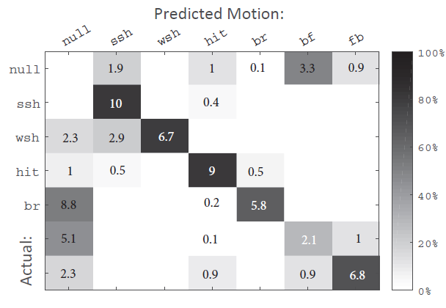
Results
Shotting and hitting recognized with high accuracy.
Overall detection rate is 0.7 (0.73 precision & 0.67 recall)
86% detection rate for determining if the player is on ice or not.
Notes:
Due to different turns, accuracy of classifier decreases

Slide 17
Conclusion & Thoughts
SkateTracker and Sensorized Hockey Stick are more of analytics/ ML with sensor data rather than an IoT application.
As the data is not gathered during an actual game, it is not possible to validate the data obtained during testing phases using GameTracker.
Testing is performed only on right handed players in GameTracker and returns faulty data for SkateTracker.
Research is performed only on a limited set of players (~ 10-15).
Notes:
More research should be carried out for increasing the accuracy of the system when different turns are performed and also for determining whether a player is in the possession of puck.

Slide 18


Slide 19
Thank You

